Slide 1
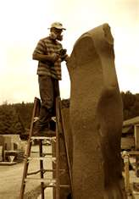
Data Sculpture
Make your data…

Slide 2

Goals
Allow an easy way to create reports with “Random Queries of Data”
Create a method to seamlessly integrate new data
Allow various forms of logic include AND, OR and More Complex Logic
Allow the data to be “saved” at point in time

Slide 3

Get New Data
Background set up with 2 types of data
Yearly
Person has more than one value
Personal
Only relates to person-one value
Application looks in one place to find data on the fly
Adding new “items” to view makes item show up to user
Named for easy understanding

Slide 4

What’s this mean
A new type of data, unknown to us before, can be sent into the application
Configuring database to tell application of new value

Slide 5
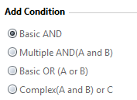
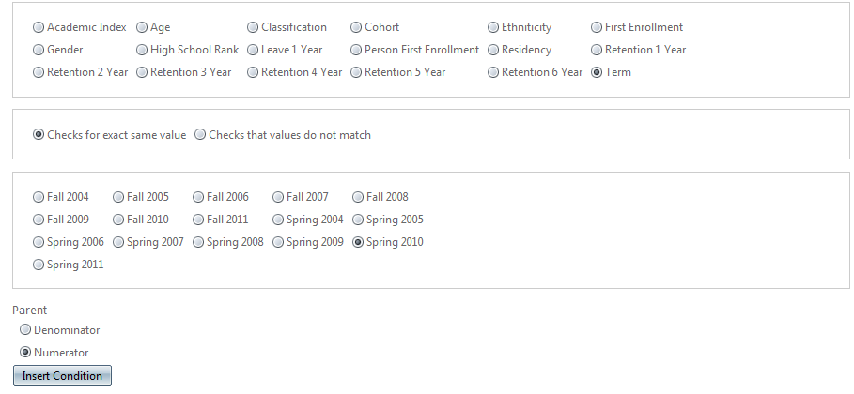
Logic and other problems
Simplified Query Templates
AND

Slide 6
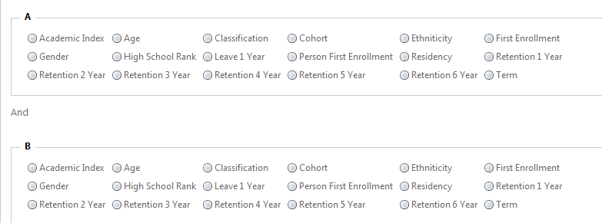
A and B

Slide 7
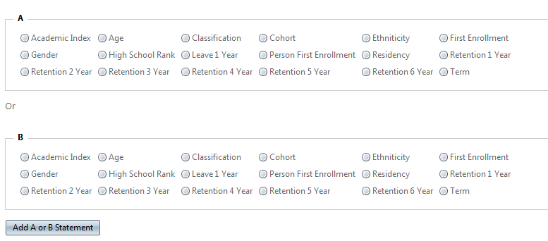
A or B

Slide 8
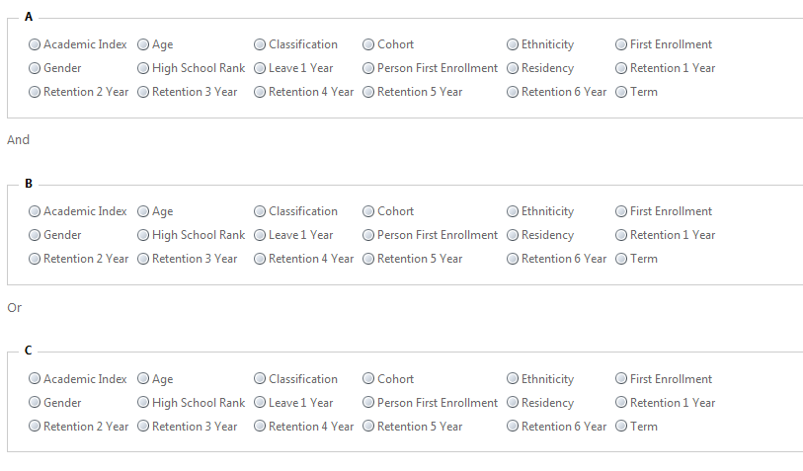
(A and B ) or C

Slide 9
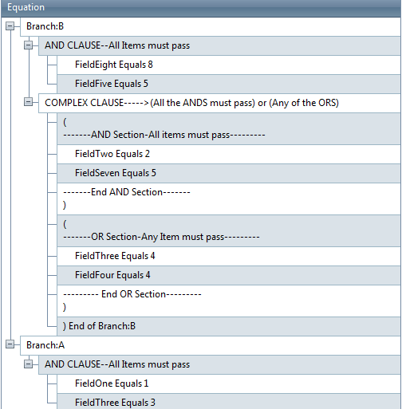
Complex Items allowed
Built In –Numerator/Denominator Branches
Really odd shapes
In English

Slide 10
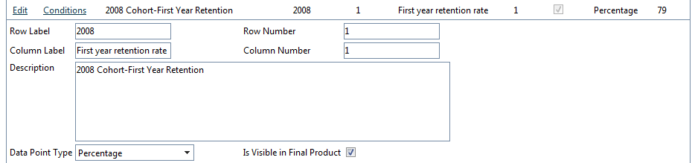
Overall Structure
Reports=one table=excel tab
Reports have various data points
Datapoints have a structure
Description
Row Label and number
Column Label and number
Value –the final value
Hidden EMPLIDs of results
Re-Usable!!

Slide 11
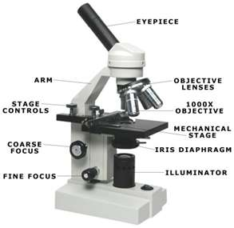
Datapoint parts
Datapoints have conditions
Conditions are just logic statements
Examples
Term Equals Fall 2010
Retention 1 Year Equals 1 (True)
Datapoints can 1 or many conditions
The program will calculate the answer by interpreting the conditions

Slide 12

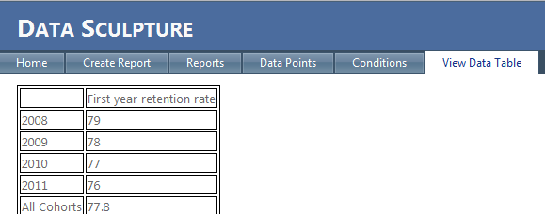
End result in table

Slide 13
Walk through some examples
Look at AZ first year rentention

Slide 14
More to come

